Slide 1
Data and Data Models
Lecture – 7
Sumita Narang

Slide 2
Objectives
Types of Data, and Datasets
Data Format
High dimensional data
Data representation - Graphs and networks, Matrices, Vectors, Data Frames, list Libraries of Graph, Matrices and vectors
Data quality
Epicycles of Data Analysis
Data Models
Model as expectation
Comparing models to reality
Reactions to Data
Refining our expectations
Six Types of the Questions
Characteristics of Good Question
Formal modelling
General Framework
Associational Analyses
Prediction Analyses

Slide 3


Data Behavior
Static data is the data which has its size/value defined at the state of
initialization. the value/size cannot be change further
Dynamic data is the data which also has its size/value defined at the
state of initialization. But unlike static data its value or size can be
changes as per the need.
22
BITS Pilani, Pilani Campus

Slide 4
Data Types & Scales 1/
TYPES OF DATA
Qualitative Data
Binary
Discrete
Continuous
Quantitative Data
Binary
Discrete
SCALES OF DATA MEASUREMENT
Qualitative Data
Interval
Quantitative Data
Nominal
Ordinal
Ratio
Notes:
Binary (0 or 1)
Discrete (specific value at a given time stamp)
Continuous (e.g. electric voltage, current, any wave)

Slide 5
Types of Data 2/
Qualitative Data - Data that approximates and characterizes.
Data type is non-numerical in nature.
Statistically also known as categorical data as can be arranged categorically/grouped based on the attributes and properties of a thing or a phenomenon.
e.g. Females have brown, black, blonde, and red hair (qualitative).
e.g. Feedback to training is good, bad, average (qualitative)
Scales
Nominal sub-type- if there is no natural order between the categories (e.g. eye colour, gender, direction); used for labelling the data
Ordinal sub-type - if an ordering exists (e.g. exam results, socio-economic status, Satisfaction score, happiness index). order of the values is what’s important and significant, but the differences between each one is not really known.

Slide 6
Types of Data 3/
Quantitative data – Data which is numeric in nature
Discrete if the measurements are integers (e.g. number of people in a household, number of cigarettes smoked per day) and
Continuous if the measurements can take on any value, usually within some range (e.g. weight).
Binary, if measurement can take just two values 0 or 1
Scales
Interval – Interval scales are numeric scales in which we know both the order and the exact differences between the values. E.g. Temperature in Degree Celsius etc.
Note- In the case of interval scales, zero doesn’t mean the absence of value, but is actually another number used on the scale, like 0 degrees celsius. So there is no true zero in value
Ratio – Ratio scale tell us about the order, they tell us the exact value between units, AND they also have an absolute zero–which allows for a wide range of both descriptive and inferential statistics to be applied.
Examples of ratio variables include height, weight, and duration

Slide 7
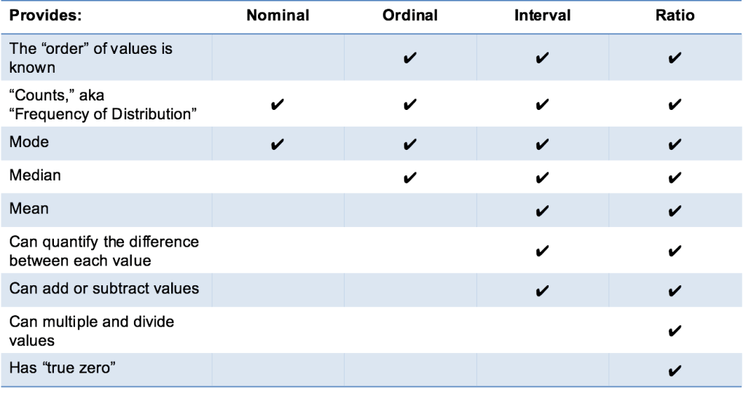
Data Formats
24
BITS Pilani, Pilani Campus

Slide 8
Exercise
Data | Type | Subtype | Scale
Age in Years | Quantitative | Discrete | Ratio
Time in AM/PM | Qualitative | Binary | Ordinal
Brightness as measured by light meter | Quantitative | Continuous | Ratio
Brightness as measured by people’s judgement | Qualitative | Discrete | Ordinal
Angles measured in degrees 0 to 360 | Quantitative | Continuous | Ratio
Bronze, Silver, Gold medals as awarded | Qualitative | Discrete | Ordinal
Height above sea level | Quantitative | Continuous | Ratio/Interval
Number of patients in a hospital | Quantitative | Discrete | Ratio
ISBN numbers for books | Qualitative | Discrete | Ordinal
Ability to pass light in terms of the following values: opaque, translucent, transparent. | Qualitative | Discrete | Ordinal
Military rank | Qualitative | Discrete | Ordinal
Distance from the center of campus | Quantitative | Continuous | Ratio/Interval
Density of a substance in grams per cubic centimeter | Quantitative | Discrete | Ratio/Interval

Slide 9
Data-set Descriptions
Source Courtesy: Some of the contents of this PPT are sourced from materials provided by publishers of prescribed books

Slide 10
Types of Data Sets
Record
Relational records
Data matrix, e.g., numerical matrix, crosstabs
Document data: text documents: term-frequency vector
Transaction data
Graph and network
World Wide Web
Social or information networks
Molecular Structures
Ordered
For some types of data, the attributes have relationships that involve order in time or space e.g. Video data: sequence of images
Temporal data: time-series
Sequential Data: transaction sequences
Genetic sequence data
Spatial, image and multimedia: -Spatial auto-correlation
Spatial data: maps
Image data:
Video data:
Notes:
May we categorize data along the following dimensions?
- structured, semi-structured, and unstructured
- numeric and categorical
- static and dynamic (temporal?)
- by application

Slide 11
Important Characteristics of Structured Data 1/
Dimensionality
The dimensionality of a data set is the number of attributes, that the objects in the data set possess. Data with a small number of dimensions, tends to be qualitatively different than moderate or high-dimensional data. Indeed, the difficulties associated with analyzing high-dimensional data are sometimes referred to as the curse of dimensionality. Because of this, an important motivation in preprocessing the data is dimensionality reduction.
Sparsity
For some data sets, such as those with asymmetric features, most attributes of an object have values of 0; in many cases fewer than 1% of the entries are non-zero. In practical terms, sparsity is an advantage because usually only the non-zero values need to be stored and manipulated. This results in significant savings with respect to computation time and storage. Furthermore some data mining algorithms work well only for sparse data.

Slide 12
Important Characteristics of Structured Data 2/
Resolution
It is frequently possible to obtain data at different levels of resolution, and often the properties of the data are different at different resolutions. For instance, the surface of the Earth seems very uneven at a resolution of a few meters, but is relatively smooth at a resolution of tens of kilometers. The patterns in the data also depend on the level of resolution. If the resolution is too fine, a pattern may not be visible or may be buried in noise; if the resolution is too coarse, the pattern may disappear. For example, variations in atmospheric pressure on a scale of hours reflect the movement of storms and other weather systems. On a scale of months, such phenomena are not detectable.
Distribution
Centrality and dispersion

Slide 13
Data Objects
Data sets are made up of data objects.
A data object represents an entity.
Examples:
sales database: customers, store items, sales
medical database: patients, treatments
university database: students, professors, courses
Also called samples , examples, instances, data points, objects, tuples.
Data objects are described by attributes.
Database rows -> data objects; columns ->attributes.

Slide 14
Attributes
Attribute (or dimensions, features, variables): a data field, representing a characteristic or feature of a data object.
E.g., customer _ID, name, address
Types:
Nominal
Binary
Numeric: quantitative
Interval-scaled
Ratio-scaled

Slide 15
Attribute Types
Nominal: categories, states, or “names of things”
Hair_color = {auburn, black, blond, brown, grey, red, white}
marital status, occupation, ID numbers, zip codes
Binary
Nominal attribute with only 2 states (0 and 1)
Symmetric binary: both outcomes equally important
e.g., gender
Asymmetric binary: outcomes not equally important.
e.g., medical test (positive vs. negative)
Convention: assign 1 to most important outcome (e.g., HIV positive)
Ordinal
Values have a meaningful order (ranking) but magnitude between successive values is not known.
Size = {small, medium, large}, grades, army rankings

Slide 16
Numeric Attribute Types
Quantity (integer or real-valued)
Interval
Measured on a scale of equal-sized units
Values have order
E.g., temperature in C˚or F˚, calendar dates
No true zero-point
Ratio
Inherent zero-point
We can speak of values as being an order of magnitude larger than the unit of measurement (10 K˚ is twice as high as 5 K˚).
e.g., temperature in Kelvin, length, counts, monetary quantities

Slide 17
Discrete vs. Continuous Attributes
Discrete Attribute
Has only a finite or countably infinite set of values
E.g., zip codes, profession, or the set of words in a collection of documents
Sometimes, represented as integer variables
Note: Binary attributes are a special case of discrete attributes
Continuous Attribute
Has real numbers as attribute values
E.g., temperature, height, or weight
Practically, real values can only be measured and represented using a finite number of digits
Continuous attributes are typically represented as floating-point variables

Slide 18
Basic Statistical Descriptions of Data
Motivation
To better understand the data: central tendency, variation and spread
Data dispersion characteristics
median, max, min, quantiles, outliers, variance, etc.
Numerical dimensions correspond to sorted intervals
Data dispersion: analyzed with multiple granularities of precision
Boxplot or quantile analysis on sorted intervals
Dispersion analysis on computed measures
Folding measures into numerical dimensions
Boxplot or quantile analysis on the transformed cube
Notes:
Note to self (MK): last part of slide does not clearly match slides that follow
Introduction slides:
In the current version, we only talk about numeric data. Can we add some materials about non-numeric data.
- text statistics, TF/IDF
- visualization of text statistics such as word cloud
- distribution of Internet (IN, SCC, OUT, …)
- visualization of social relationship (e.g., http://renlifang.msra.cn/)

Slide 19
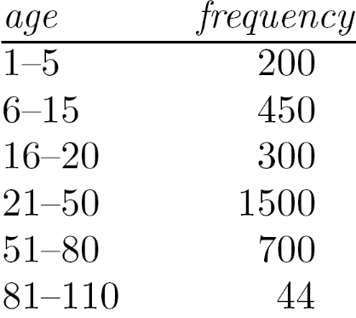
Measuring the Central Tendency
Mean (algebraic measure) (sample vs. population):
Note: n is sample size and N is population size.
Weighted arithmetic mean:
Trimmed mean: chopping extreme values
Median:
Middle value if odd number of values, or average of the middle two values otherwise
Estimated by interpolation (for grouped data):
Mode
Value that occurs most frequently in the data
Unimodal, bimodal, trimodal
Empirical formula:
Median interval

Slide 20
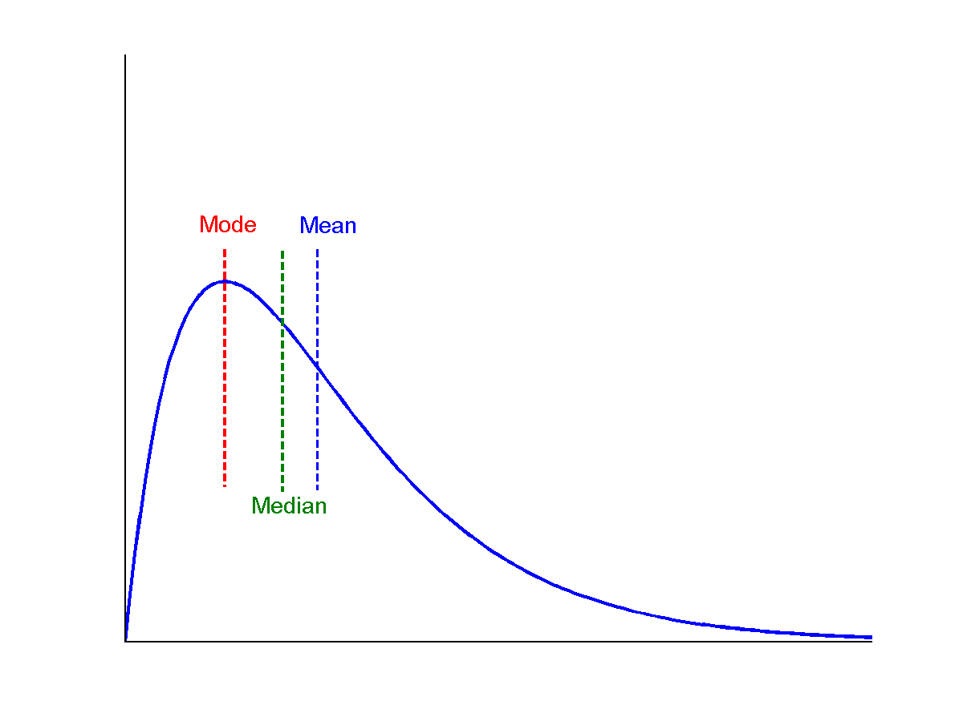
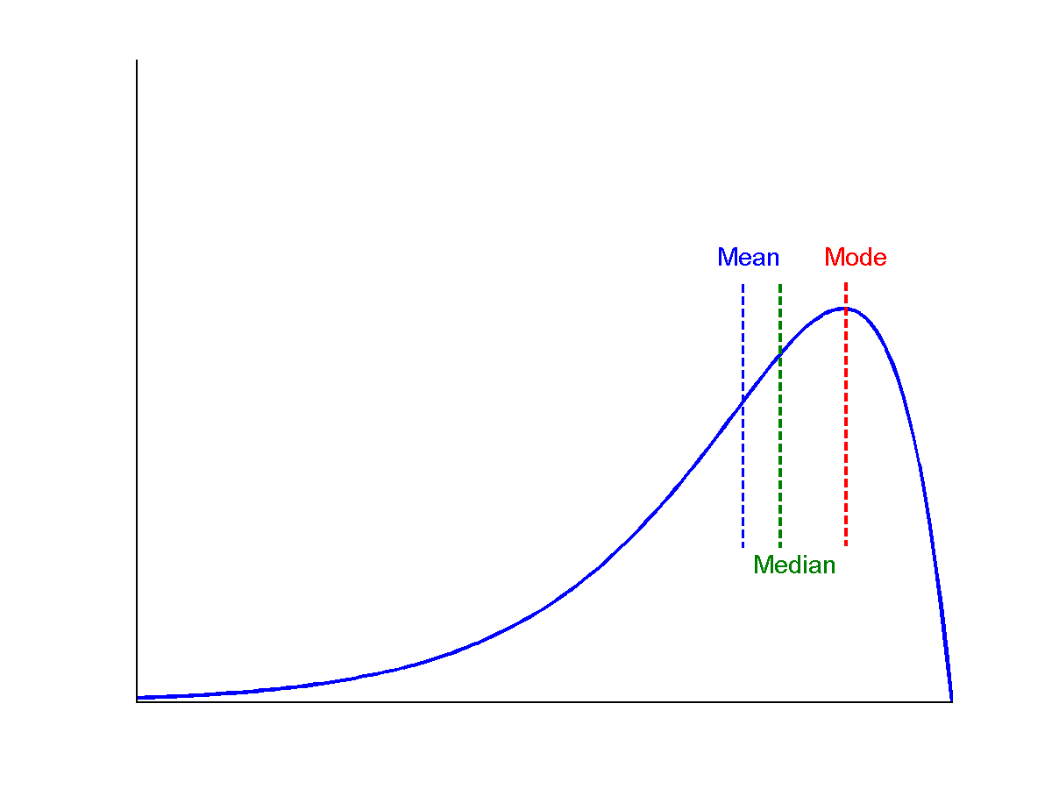
Symmetric vs. Skewed Data
Median, mean and mode of symmetric, positively and negatively skewed data
symmetric
positively skewed
negatively skewed

Slide 21
Measuring the Dispersion of Data
Quartiles, outliers and boxplots
Quartiles: Q₁ (25th percentile), Q₃ (75th percentile)
Inter-quartile range: IQR = Q₃ – Q₁
Five number summary: min, Q₁, median, Q₃, max
Boxplot: ends of the box are the quartiles; median is marked; add whiskers, and plot outliers individually
Outlier: usually, a value higher/lower than 1.5 x IQR
Variance and standard deviation (sample: s, population: σ)
Variance: (algebraic, scalable computation)
Standard deviation s (or σ) is the square root of variance s² ⁽or σ²⁾

Slide 22
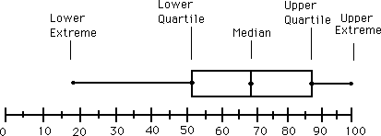
Boxplot Analysis
Five-number summary of a distribution
Minimum, Q1, Median, Q3, Maximum
Boxplot
Data is represented with a box
The ends of the box are at the first and third quartiles, i.e., the height of the box is IQR
The median is marked by a line within the box
Whiskers: two lines outside the box extended to Minimum and Maximum
Outliers: points beyond a specified outlier threshold, plotted individually
Notes:
Redraw the boxplot! Yes, we need a more real boxplot graph!

Slide 23
Graphic Displays of Basic Statistical Descriptions
Boxplot: graphic display of five-number summary
Histogram: x-axis are values, y-axis repres. frequencies
Quantile plot: each value x_{i} is paired with f_{i} indicating that approximately 100 f_{i} % of data are ≤ x_{i}
Quantile-quantile (q-q) plot: graphs the quantiles of one univariant distribution against the corresponding quantiles of another
Scatter plot: each pair of values is a pair of coordinates and plotted as points in the plane
Notes:
JH: Maybe we can remove Loess curve

Slide 24
Histogram Analysis
Histogram: Graph display of tabulated frequencies, shown as bars
It shows what proportion of cases fall into each of several categories
Differs from a bar chart in that it is the area of the bar that denotes the value, not the height as in bar charts, a crucial distinction when the categories are not of uniform width
The categories are usually specified as non-overlapping intervals of some variable. The categories (bars) must be adjacent
Notes:
JH: A better and BASIC histogram figure --- because this one overlaps with a later one!

Slide 25
Histograms Often Tell More than Boxplots
The two histograms shown in the left may have the same boxplot representation
The same values for: min, Q1, median, Q3, max
But they have rather different data distributions

Slide 26
Handling Non-Record Data
Unstructured data, which is not available as records.
Most data mining algorithms are designed for record data or its variations, such as transaction data and data matrices. Record-oriented techniques can be applied to non-record data by extracting features from data objects and using these features to create a record corresponding to each object.
Consider spatio-temporal data consisting of a time series from each point on a spatial grid. This data is often stored in a data matrix, where each row represents a location and each column represents a particular point in time.
However, such a representation does not explicitly capture the time relationships that are present among attributes and the spatial relationships that exist among objects. This does not mean that such a representation is inappropriate, but rather that these relationships must be taken into consideration during the analysis.
For example, it would not be a good idea to use a data mining technique that assumes the attributes are statistically independent of one another.

Slide 27
Prescribed Text Books
 | Author(s), Title, Edition, Publishing House
T1 | Tan P. N., Steinbach M & Kumar V. “Introduction to Data Mining” Pearson Education
T2 | Data Mining: Concepts and Techniques, Third Edition by Jiawei Han, Micheline Kamber and Jian Pei Morgan Kaufmann Publishers

Slide 28
Data Representation
Source Courtesy: Some of the contents of this PPT are sourced from materials provided by publishers of prescribed books

Slide 29
Vector in Data Science
A vector is a tuple of one or more values called scalars.
Vectors can be represented in Python in different ways; known as Sequence Data Types
Lists
Tuples
Ranges
Arrays
Vector Arithmetic
Vector Addition -> c = a + b
a + b = (a1 + b1, a2 + b2, a3 + b3)
Vector Subtraction
Vector Multiplication
Vector Division
Vector Dot Product

Slide 30
Sequence Types in Python - Lists, tuples , Range 1/
https://docs.python.org/3/library/stdtypes.html#sequence-types-list-tuple-range
A list is simply an ordered collection of items.
Lists, Tuples, and Strings are all data types that, in python, are called sequence data types. All of them are containers of items and all of them have items that are ordered.
A Tuple is also an ordered collection of items.
Similarity –
Both lists and tuples are sequence data types that can store a collection of items.
Each item stored in a list or a tuple can be of any data type.
And you can also access any item by its index.
Differences –
The main difference between lists and a tuples is the fact that lists are mutable whereas tuples are immutable
List defined via List () function; assigned values by [ l1, l2 ,l3] i.e. square brackets. Tuples are defined via round brackets (l1,l2,l3) is tuple
Lists can grow dynamically as they are mutable objects.

Slide 31
Sequence Types in Python - Lists, tuples , Range 2/
The range type represents an immutable sequence of numbers and is commonly used for looping a specific number of times in for loops.
list(range(10)) is same as [0, 1, 2, 3, 4, 5, 6, 7, 8, 9]
list(range(1,11) is same as [1, 2, 3, 4, 5, 6, 7, 8, 9, 10]
list(range(0, 30, 5)) is same as [0, 5, 10, 15, 20, 25]
list(range(0, 10, 3)) is same as [0, 3, 6, 9]
list(range(0, -10, -1)) is same as [0, -1, -2, -3, -4, -5, -6, -7, -8, -9]
list(range(0)) is same as []
list(range(1, 0)) is same as []

Slide 32
Lists and Arrays
https://medium.com/backticks-tildes/list-vs-array-python-data-type-40ac4f294551
https://www.pythoncentral.io/the-difference-between-a-list-and-an-array/
Apparently, an Array is a data type in Python also, meaning we have the array type and list type (the list type being more popular).
The most popular type of array used in Python is the numpy array.
Similarities-
Both can be used to store any data type (real numbers, strings, etc)
Both can be indexed and iterated
Both can be sliced
Both are mutable
Differences-
The main difference between these two data types is the operation you can perform on them. Arrays are specially optimized for arithmetic computations so if you’re going to perform similar operations you should consider using an array instead of a list. E.g. x = array([3, 6, 9, 12])
x/3.0
print(x) -> array([1, 2, 3, 4])
Also lists are containers for elements having differing data types but arrays are used as containers for elements of the same data type.
It does take an extra step to use arrays because they have to be declared while lists don't because they are part of Python's syntax,

Slide 33
Exercise – Lists, Arrays, tuples
https://www.w3resource.com/python-exercises/list/
https://www.w3resource.com/python-exercises/tuple/
https://www.w3resource.com/python-exercises/array/

Slide 34
2-Dimensional Data
Data can be stored in python in 3 ways –
2D array or 2D List
Matrix
Pandas Data frame
Details –
2D Arrays - https://www.tutorialspoint.com/python/python_2darray.htm
Two dimensional array is an array within an array. It is an array of arrays. In this type of array the position of an data element is referred by two indices instead of one. So it represents a table with rows and columns of data. In the below example of a two dimensional array, observer that each array element itself is also an array.

Slide 35
Matrix
https://www.tutorialspoint.com/python/python_matrix.htm
Matrix is a special case of two dimensional array where each data element is of strictly same size. So every matrix is also a two dimensional array but not vice versa.
For example following 2 D array is allowed, but this data cannot go into a matrix –
2 | 3 | 4
1 | 12 | 14
1 | 2
The above data can be represented as a two dimensional array as below.
[['Mon' '18' '20' '22' '17']
['Tue' '11' '18' '21' '18']
['Wed' '15' '21' '20' '19']
['Thu' '11' '20' '22' '21']
['Fri' '18' '17' '23' '22']
['Sat' '12' '22' '20' '18']
['Sun' '13' '15' '19' '16']]
from numpy import * a = array([['Mon',18,20,22,17],['Tue',11,18,21,18], ['Wed',15,21,20,19],['Thu',11,20,22,21], ['Fri',18,17,23,22],['Sat',12,22,20,18], ['Sun',13,15,19,16]]) m = reshape(a,(7,5)) print(m)

Slide 36
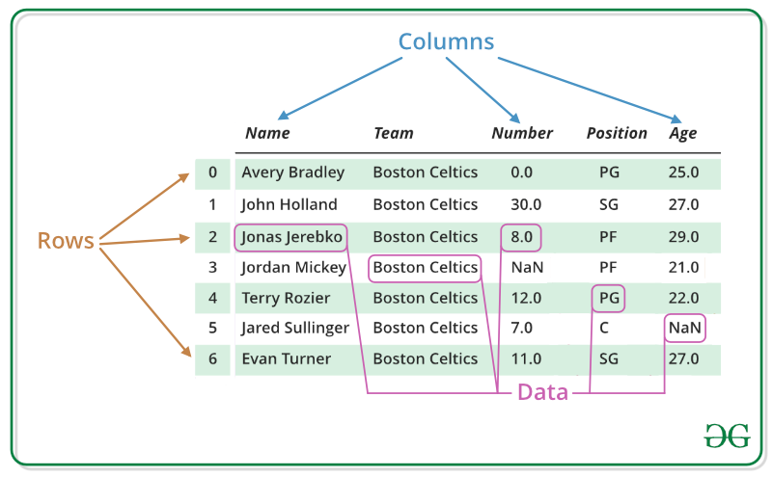
Data Frames
https://www.geeksforgeeks.org/python-pandas-dataframe/
Pandas DataFrame is two-dimensional size-mutable, potentially heterogeneous tabular data structure with labeled axes (rows and columns). A Data frame is a two-dimensional data structure, i.e., data is aligned in a tabular fashion in rows and columns. Pandas DataFrame consists of three principal components, the data, rows, and columns.

Slide 37
Graphs Representation
https://www.geeksforgeeks.org/graph-and-its-representations/
https://www.scribd.com/doc/104543388/Graph-Representation
G=(V,E)
•A graph is a set of vertices and edges. A vertex may represent a state or a condition while the edge may represent a relation between two vertices.
Following two are the most commonly used representations of a graph. 1. Adjacency Matrix 2. Adjacency List

Slide 38
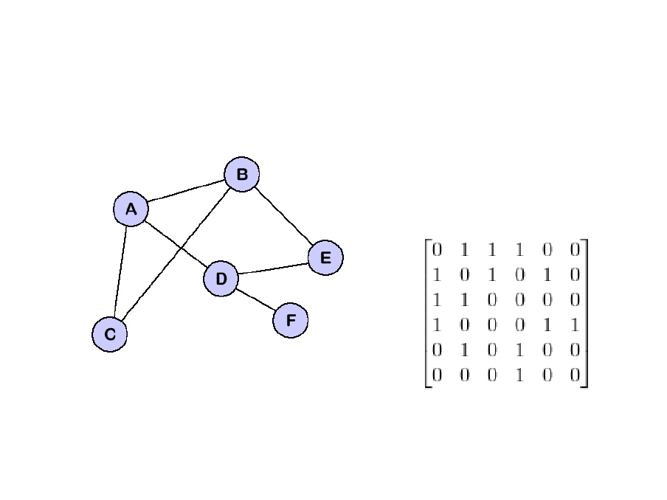
Adjacency Matrix
Adjacency Matrix is a 2D array of size V x V where V is the number of vertices in a graph. Let the 2D array be adj[][], a slot adj[i][j] = 1 indicates that there is an edge from vertex i to vertex j. Adjacency matrix for undirected graph is always symmetric. Adjacency Matrix is also used to represent weighted graphs. If adj[i][j] = w, then there is an edge from vertex i to vertex j with weight w.
Pros: Representation is easier to implement and follow. Removing an edge takes O(1) time. Queries like whether there is an edge from vertex ‘u’ to vertex ‘v’ are efficient and can be done O(1).
Cons: Consumes more space O(V^2). Even if the graph is sparse(contains less number of edges), it consumes the same space. Adding a vertex is O(V^2) time.

Slide 39
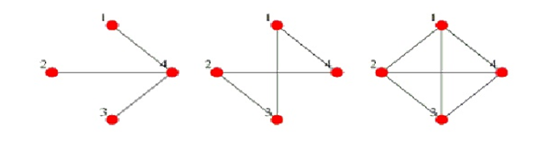
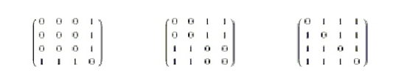
Adjacency Matrix

Slide 40
Adjacency List
An array of lists is used. Size of the array is equal to the number of vertices. Let the array be array[]. An entry array[i] represents the list of vertices adjacent to the ith vertex. This representation can also be used to represent a weighted graph. The weights of edges can be represented as lists of pairs. Following is adjacency list representation of the above graph.

Slide 41
Where to use what
• Adjacency matrix is good for dense graphs.
• Adjacency lists is good for sparse graphs and also for changing the no of nodes.

Slide 42
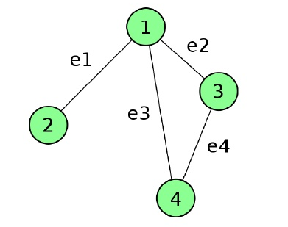
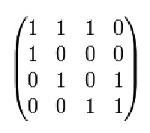
Incidence Matrix Representation
The Incidence matrix of a graph G with N vertices and E edges is N x E.
Mij = 1 if ej is incident on vi
Mij = 0 otherwise

Slide 43

Sparse Matrix (1/3)
• Sparse Matrix is a matrix which contains very few non-zero elements.
• When a sparse matrix is represented with a 2-dimensional array, we waste a
lot of space to represent that matrix.
• For example, consider a matrix of size 100 X 100 containing only 10 non-
zero elements. In this matrix, only 10 spaces are filled with non-zero values
and remaining spaces of the matrix are filled with zero. That means, we
allocate 100 X 100 X 2 = 20000 bytes of space to store this integer matrix.
• Sparse Matrix Representations can be done in many ways following are two
common representations:
o Array Representation
o Linked List representation
Sources: http://btechsmartclass.com/data_structures/sparse-matrix.html
https://www.geeksforgeeks.org/sparse-matrix-representation/
10
BAZG523(Introduction to Data Science)

Slide 44
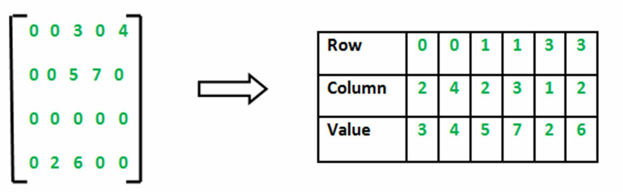
Sparse Matrix (2/3)
Array Representation
2D array is used to represent a sparse matrix in which there are three rows
named as follows:
• Row: Index of row, where non-zero element is located
• Column: Index of column, where non-zero element is located
• Value: Value of the non zero element located at index – (Row, Column)
Sources: http://btechsmartclass.com/data_structures/sparse-matrix.html
https://www.geeksforgeeks.org/sparse-matrix-representation/
11
BAZG523(Introduction to Data Science)

Slide 45
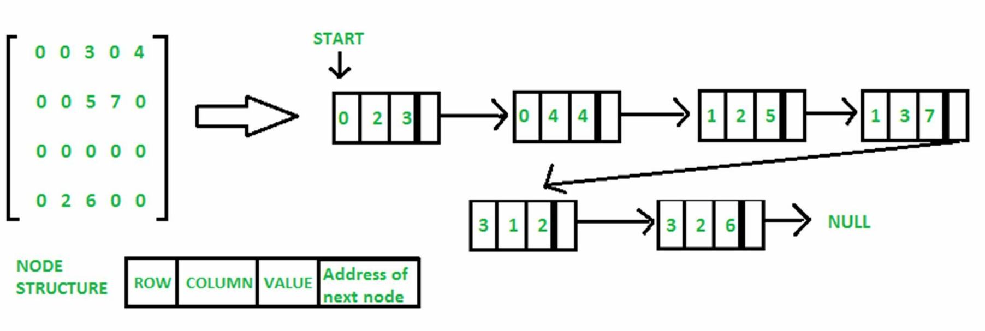
Sparse Matrix (3/3)
Linked List Representation
In linked list, each node has four fields, which are defined as follows:
• Row: Index of row, where non-zero element is located
• Column: Index of column, where non-zero element is located
• Value: Value of the non zero element located at index – (row, column)
• Next node: Address of the next node.
Sources: http://btechsmartclass.com/data_structures/sparse-matrix.html
https://www.geeksforgeeks.org/sparse-matrix-representation/
12
BAZG523(Introduction to Data Science)

Slide 46
Libraries – Graphs and Networks in Python
https://www.python-course.eu/graphs_python.php
https://www.python.org/doc/essays/graphs/
graph = { "a" : ["c"],
"b" : ["c", "e"],
"c" : ["a", "b", "d", "e"],
"d" : ["c"],
"e" : ["c", "b"],
"f" : [] }

Slide 47
Data Coding Formats
Data Format defines the format in which data is coded.
The information is coded in such a way that a program or application can recognize, read and use the data.
If software/hardware is no longer used, data can become unreadable. In order to prevent this, it is vital to choose an open format: that is a software format that is not attached to a certain software supplier (proprietary software).
Data formats are often indicated by their MIME type. MIME stands for Multipart (Multipurpose) Internet Mail Extension. MIME provides web browser information on how to deal with a file.
A MIME type is noted as two indications separated by a slash (MIME type/subtype). Example: text/plain is the MIME type for plain text.

Slide 48
Data Coding Formats
Application/subtypes | Text/subtypes | Numerical data formats
Application/pdf: In transferring a file from one program to another, text layout has a tendency to shift or disappear. To prevent this, applications exist that ensure a universally identical rendering of the document. One example is the PDF (Portable Document Format) type, a universal file format for the electronic exchange of documents while maintaining their layout. | Text/plain: means that the text has not been given any layout. | application/x-matlab-data numerical data type: MATLAB is an advanced scientific computation program.
Application/gml+xml: GML stands for Geographic Markup Language: a standard way of describing geographic information. Geographic data describe the world in spatial terms, in regular plain text. As such, this is a language independent of any sort of data visualization | Text/HTML (HyperText Markup Language) is a format that indicates how the information should be visualized on a website. Its code allows you to indicate what text should look like, for example bold or in italics. This kind of layout is not present in plain text format. | HDF5 (application/x-hdf5) & NetCDF (application/x-netcdf): : store large amounts of numerical data (information in the form of numbers). A file containing numerical data is also called a binary file. Represent dataset with multidimensional arrays. HDF5 and NetCDF allow you to add metadata to the dataset as a whole, but also to the variables and dimensions within the set. Both HDF5 and NetCDF have standard definitions for the values plotted on specific axes.
Application/vnd.google-earth.kml+xml: geographic data is encoded in such a way that it can be read by so-called earth browsers, such as Google Earth, Google Maps, and Google Maps for mobile. Unlike the standard GML format, earth browsers do visualize data. | Text/XML (eXtensible Markup Language) format does not include layout either, but allows you to provide additional information about the contents of the file. Metadata can be added, such as <title> for a title and <creator> for the person who created the document
Application/x-java-archive: dataset is related to the Java programming language.
Application/octet-stream: This MIME type covers a general kind of binary data not otherwise defined. It is a residual category used for datasets of an unclear or uncertain nature

Slide 49
Data Formats
Still Image | Geospatial | Graphic Image | Audio | Video | Database
TIFF, JPEG 2000, PNG, JPEG/JFIF, DNG (digital negative), BMP, GIF. | Shapefile (SHP, DBF, SHX), GeoTIFF, NetCDF. | raster formats: TIFF, JPEG2000, PNG, JPEG/JFIF, DNG, BMP, GIF. | WAVE, AIFF, MP3, MXF, FLAC. | MOV, MPEG-4, AVI, MXF. | XML, CSV, TAB
 |  | vector formats: Scalable vector graphics, AutoCAD Drawing Interchange Format, Encapsulated Postscripts, Shape files. |  |  | RDBMS
 |  | cartographic: Most complete data, GeoTIFF, GeoPDF, GeoJPEG2000, Shapefile. |  |  | NOSQL

Slide 50
Data Quality
Source Courtesy: Some of the contents of this PPT are sourced from materials provided by publishers of prescribed books

Slide 51
Data Quality 1/
Data quality is a perception or an assessment of data's fitness to serve its purpose in a given context.
Accuracy
Measure of correctness of measured values
Precision of values – 32 bit, 64 bit
Completeness
Measure of data availability for all real-time scenarios
Handling Missing values
Reliability/Comparability
Measure of consistency in data
Degree to which data can be compared over time and domain
Relevance
Data collected for the same purpose which is relevant for the current use case under observation
Timeliness And Punctuality
Defines if data is latest/current
With change in environmental factors, older data may become outdated and hence unusable
Accessibility / Clarity
Ease with which data can be accessed. Formats in which data is available & supporting information defining those formats
Clarity implies sufficiency of metadata, supportive information

Slide 52
Data Quality
What kinds of data quality problems?
How can we detect problems with the data?
What can we do about these problems?
Examples of data quality problems:
Measurement and Collection Errors
Accuracy, Precision and Bias in data
Noise and Outliers
Missing values
Duplicate data

Slide 53
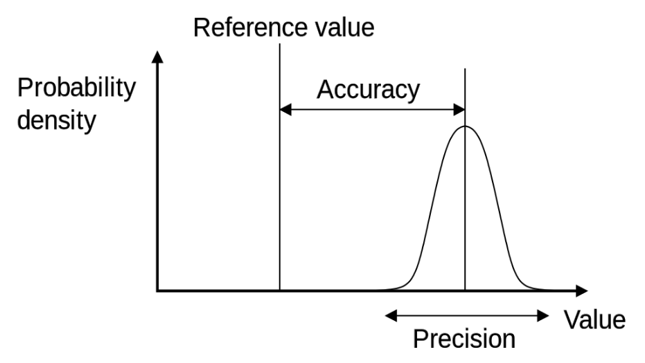
Data Quality – Accuracy Measure Statistically
Accuracy – Measure of how close the current value is to the “True/Reference value”.
The term measurement error refers to any problem resulting from the measurement process. A common problem is that the value recorded differs from the true value to some extent. For continuous attributes, the numerical difference of the measured and true value is called the error.
The term data collection error refers to errors such as omitting data objects or attribute values, or inappropriately including a data object. For example, a study of animals of a certain species might include animals of a related species that are similar in appearance to the species of interest.
Both measurement errors and data collection errors can be either systematic or random.
Precision refers to unreproducible random measurement error that leads to variation among multiple measurements of the same quantity; how close the data is with each other. Definition 2.3 (Precision). The closeness of repeated measurements( of the same quantity) to one another.
Definition 2.4 (Bias). A systematic variation of measurement from the quantity being measured
Variance (S²) = average squared deviation of values from mean
[squaring deviation from the mean] ÷ number of observations = variance
Standard deviation (S) = square root of the variance
Standard deviation of this random noise characterizes the precision of the measurement instrument (where a larger standard deviation corresponds to poorer precision).
Variance is a measure of heterogeneity in a given data. Higher the variance, more heterogeneous is it and smaller the variance, more homogeneous is it.
https://www.youtube.com/watch?v=0IiHPKAvo7g

Slide 54
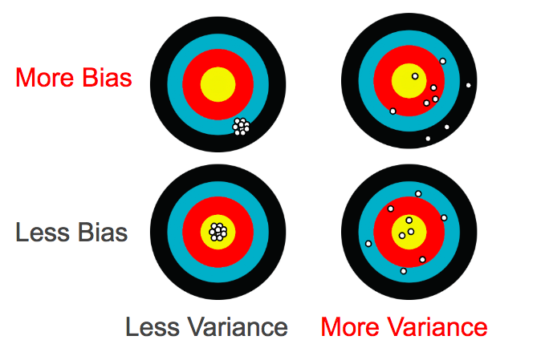
What is Bias & Variance in data
https://towardsdatascience.com/what-is-ai-bias-6606a3bcb814

Slide 55
Noise
Noise is the random component of a measurement error. It may involve the distortion of a value or the addition of spurious objects.
The term noise is often used in connection with data that has a spatial or temporal component.
In such cases, techniques from signal or image processing can frequently be used to reduce noise and thus, help to discover patterns(signals) that might be "lost in the noise." Nonetheless, the elimination of noise is frequently difficult, and much work in data mining focuses on devising robust algorithms that produce acceptable results even when noise is present.
(a) Time series.
(b) Time series with noise.

Slide 56
Outliers
Outliers are either
(1) data objects that, in some sense, have characteristics that are different from most of the other data objects in the data set, or
(2) values of an attribute that are unusual with respect to the typical values for that attribute. Alternatively, we can speak of anomalous objects or values.
Furthermore, it is important to distinguish between the notions of noise and outliers. Outliers can be legitimate data objects or values. Thus, unlike noise, outliers may sometimes be of interest.
In fraud and network intrusion detection, for example, the goal is to find unusual objects or events from among a large number of normal ones.

Slide 57
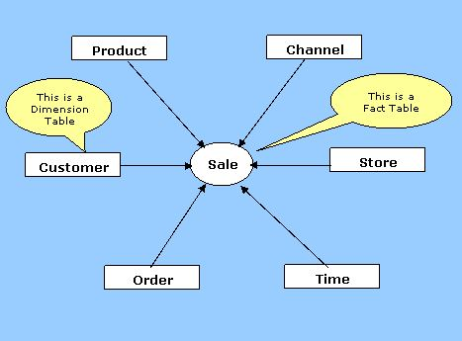
Data Dimensions
A Data Dimension is a set of data attributes pertaining to something of interest to a business.
Dimensions store the textual descriptions of the business. With out the dimensions, we cannot measure the facts. The different types of dimension tables are explained in detail below.
For example, a business might want to know how may blue widgets were sold at a specific store in India last month.

Slide 58
High Dimensionality of Data
High Dimensional means that the number of dimensions are staggeringly high — so high that calculations become extremely difficult. With high dimensional data, the number of features can exceed the number of observations.
For example, microarrays, which measure gene expression, can contain tens of hundreds of samples. Each sample can contain tens of thousands of genes.
So if “p” is the number of dimensions and “n” is the number of observations, then if “p > n” it is a high dimension dataset i.e. the number of features available in dataset is more that the number of observations available.

Slide 59
Curse of Dimensionality
The curse of dimensionality usually refers to what happens when you add more and more variables to a multivariate model. Each added variable results in an exponential decrease in predictive power.
The statistical curse of dimensionality refers to a related fact: a required sample size n will grow exponentially with data that has d dimensions. In simple terms, adding more dimensions could mean that the sample size you need quickly become unmanageable.

Slide 60
Epicycle of Data Analysis
Source Courtesy: Some of the contents of this PPT are sourced from materials provided by publishers of prescribed books

Slide 61
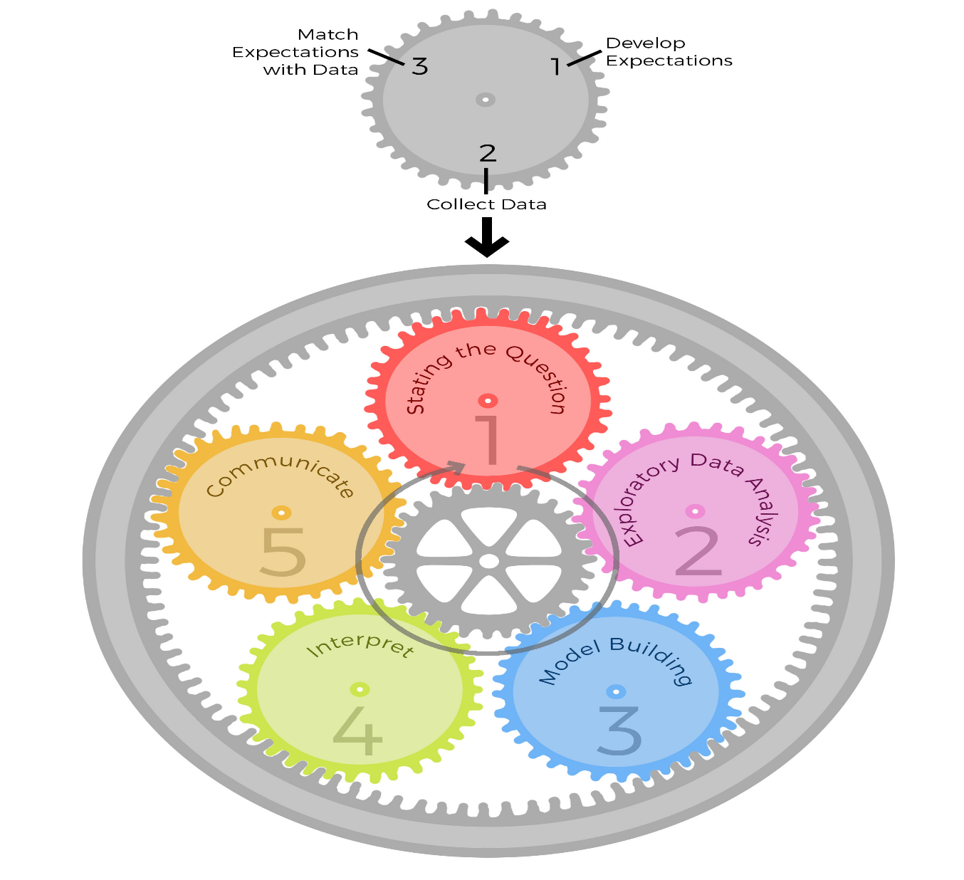
Epicycle of Data Analysis
https://bookdown.org/rdpeng/artofdatascience/epicycles-of-analysis.html
There are 5 core activities of data analysis:
Stating and refining the question
Exploring the data
Building formal statistical models
Interpreting the results
Communicating the results
More specifically, for each of the five core activities, it is critical that you engage in the following steps:
Setting Expectations,
Collecting information (data), comparing the data to your expectations, and if the expectations don’t match,
Revising your expectations or fixing the data so your data and your expectations match.
Iterating through this 3-step process is what we call the
“epicycle of data analysis.” As you go through every stage of an analysis, you will need to go through the epicycle to continuously refine your question, your exploratory data analysis, your formal models, your interpretation, and your communication.

Slide 62
References
https://unstats.un.org/unsd/dnss/docs-nqaf/UK-Guidelines_Subject.pdf
https://www.folkstalk.com/2010/01/types-of-dimensions.html?m=1
https://www.folkstalk.com/2010/01/data-warehouse-dimensional-modelling.html
https://www.metrology-journal.org/articles/ijmqe/full_html/2017/01/ijmqe160046/ijmqe160046.html

Slide 63
Appendix
Extra Read

Slide 64
Type of Data Dimensions
Dimensions Types
Conformed Dimensions
Junk Dimensions
Degenerated Dimensions
Role-playing Dimensions
Conformed dimensions mean the exact same thing with every possible fact table to which they are joined; e.g. The date dimension connected to the sales facts is identical to the date dimension connected to the inventory facts
Junk dimension is a collection of random transactional codes or text attributes; to correlate some unrelated attributes. E.g. gender & marital status dimension can be combined as one junk attribute which stores all possible combinations of these 2 attribute values
Degenerated Dimension is a dimension which is derived from the fact table and doesn't have its own dimension table. E.g. Transactional Ids in fact table.
Role-playing dimensions are dimensions which are often used for multiple purposes within the same database. For example, a date dimension can be used for “date of sale", as well as "date of delivery", or "date of hire"

Slide 65
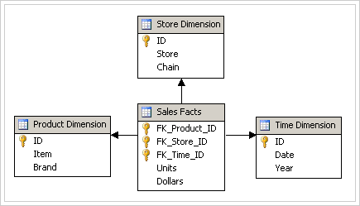
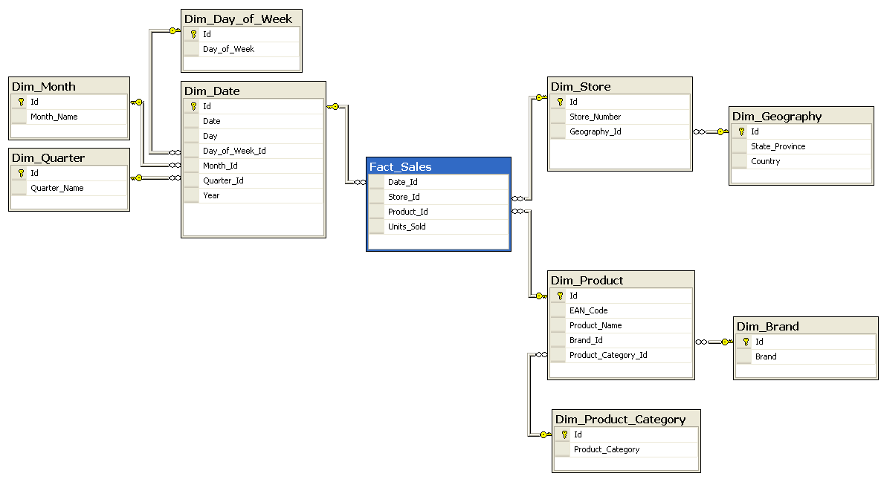
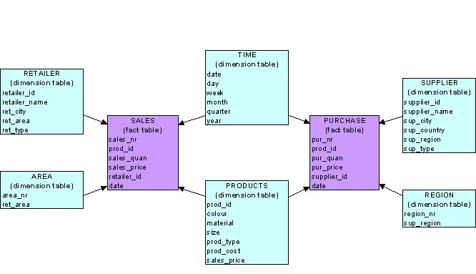
Data Dimensions- Storage Schemas
Star Schema: A schema is the one in which a central fact table is surrounded by de-normalized dimensional tables. A star schema can be simple or complex. A simple star schema consists of one fact table where as a complex star schema have more than one fact table.
Snow flake Schema: A snow flake schema is an enhancement of star schema by adding additional dimensions. Snow flake schema are useful when there are low cardinality attributes in the dimensions
Galaxy Schema: Galaxy schema contains many fact tables with some common dimensions (conformed dimensions). This schema is a combination of many data marts
Notes:
In the context of databases, cardinality refers to the uniqueness of data values contained in a column. High cardinality means that the column contains a large percentage of totally unique values. Low cardinality means that the columncontains a lot of “repeats” in its data range

